Slide 1
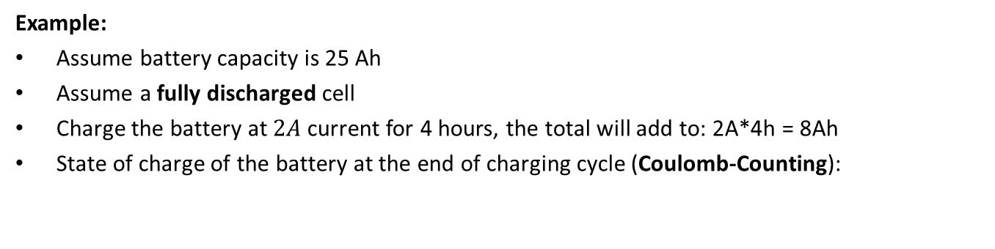

BATTERY CHARGING: BATTERY STATE OF CHARGE (%)
Example:
Assume battery capacity is 25 Ah
Assume a fully discharged cell
Charge the battery at $2A$ current for 4 hours, the total will add to: 2A*4h = 8Ah
State of charge of the battery at the end of charging cycle (Coulomb-Counting):
$SOC= \frac{Total Charge Input}{Maximum Cell Capacity}=\frac{8 Ah}{25 Ah}=32\%$

Slide 2
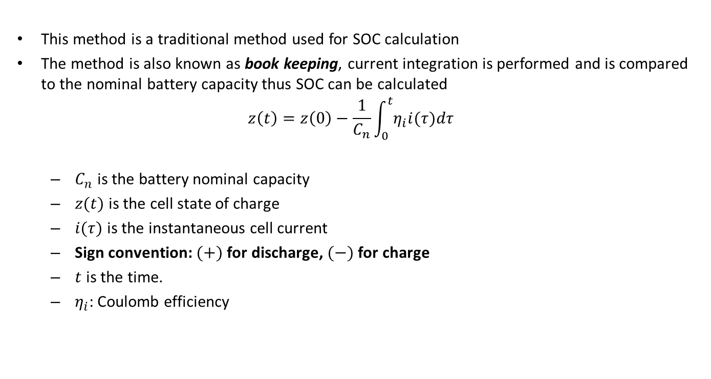
BATTERY CHARGING: TIME DOMAIN
This method is a traditional method used for SOC calculation
The method is also known as book keeping, current integration is performed and is compared to the nominal battery capacity thus SOC can be calculated
$$z\left(t\right)=z\left(0\right)−\frac{1}{C_{n}}\int_{0}^{t}{η_{i}i(τ)dτ}$$
$C_{n}$ is the battery nominal capacity
$z(t)$ is the cell state of charge
$i(τ)$ is the instantaneous cell current
Sign convention: $(+)$ for discharge, $(−)$ for charge
$t$ is the time.
$η_{i}$: Coulomb efficiency
Notes:
What we just did in this example is that we added up or “integrated” the current going into the battery in a specific period of time and then divided by the total capacity. Therefore the Coulomb counting equation can be written as follows:
$$SOC\left(t\right)=SOC\left(0\right)−\frac{1}{C_{n}}\int_{0}^{t}{i(τ)dτ}$$
Where, the battery state of charge at time t is equal to the battery initial state of charge indicated by SOC at time zero and then subtracted from the integral of the current from time zero to time t and then finally divided by the battery capacity indicated by the term “Cn”.
One note to consider is that current sign convention is positive when the battery is discharged and negative when the battery is charged. Therefore, the battery state of charge increase when the current is negative because the integral term becomes positive and decreases when the current is positive because the term becomes negative.

Slide 3
BATTERY CHARGING: ADVANTAGES/DISADV.
Advantages:
The main advantage of coulomb counting is that it is simple to be implemented
It can be applied to all battery chemistries
Disadvantages:
Requires regular need for calibration since error accumulation occurs (due to sensor noise and inaccuracies) over time due to integration.
A complete charge and discharge has to be conducted which limits its practical applications
Requires an accurate initial SOC in order to provide an acceptable accuracy
Additional information such as cell temperature, charge/discharge efficiency, and capacity degradation due to cycling can enhance the accuracy of the coulomb counting technique
Notes:
The main advantage of coulomb counting is that it is simple to be implemented and can be applied to all battery chemistries
- However, the technique requires regular need for calibration since error accumulation occurs (due to sensor noise and inaccuracies) over time due to integration.
And it requires an accurate initial SOC in order to provide an acceptable accuracy
In addition, additional information such as cell temperature, charge/discharge efficiency, and capacity degradation due to cycling can enhance the accuracy of the coulomb counting technique

Slide 4
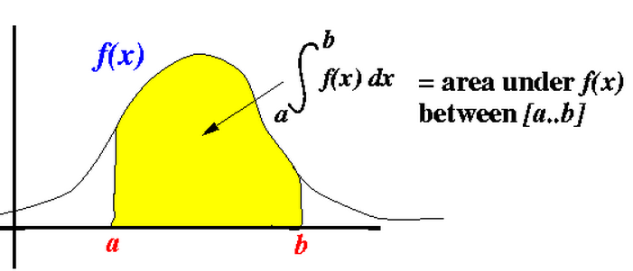
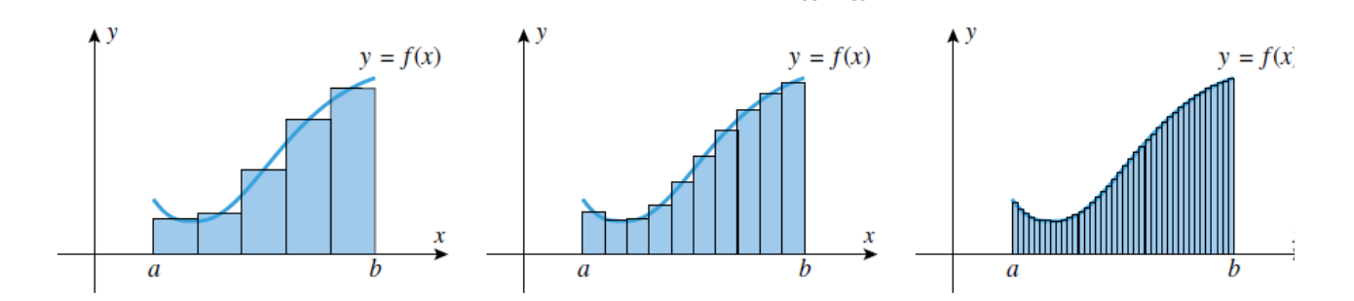
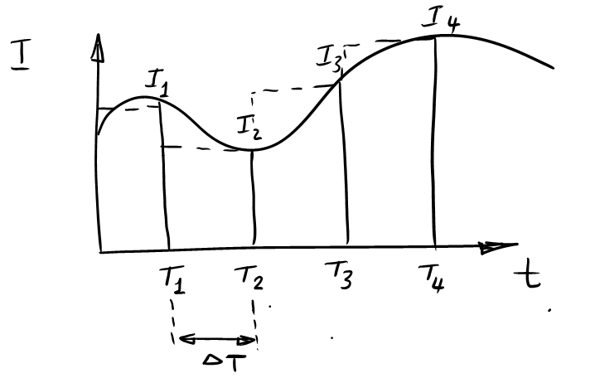

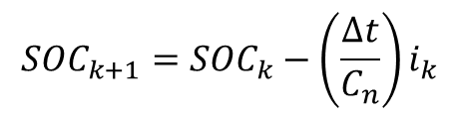
BATTERY CHARGING: DISCRETE TIME DOMAIN
Integration of the function $f(x)$represents the area under the curve
$${SOC}_{k+1}={SOC}_{k}−\left(\frac{∆t}{C_{n}}\right)i_{k}$$
http://www.mathcs.emory.edu/~cheung/Courses/170/Syllabus/07/rectangle-method.html
Notes:
- Let’s review two basic concepts, (1) A discrete-time sequence {$x[k]$} may be generated by periodically sampling a continuous-time signal at uniform intervals of time.
- The spacing $T_{s}$ between two consecutive samples is called the sampling interval or sampling period
- The Reciprocal of sampling interval $T_{s}$, denoted as $F$, is called the sampling frequency:
$$F=1/T_{s}$$
As you sample at a higher sampling frequency, you are capturing more samples and you are increasing the accuracy of the signal.
The second concept is if you have a continuous function f(x), by Integration of the function $f\left(x\right),$ you are calculating the area under the curve.
In BMS, as we calculate the SOC using coulomb counting, you are integrating the current, so you are essentially calculating the area under the curve as shown in the figure. Every time you take a current sample, you multiply the current by the sampling interval DetlaT and sum it up to the total Ah accumulated to this moment and that’s how you update the battery SOC.

Slide 5
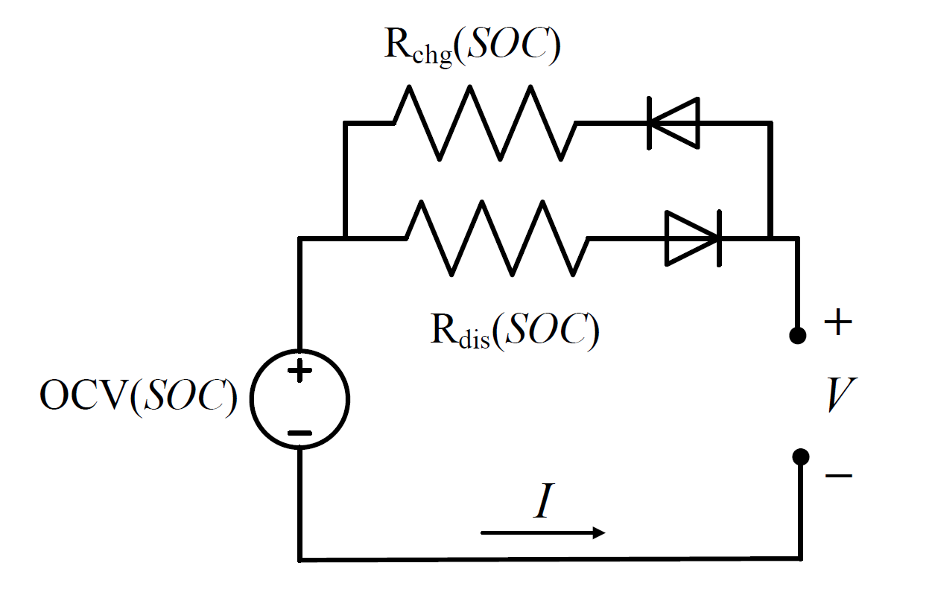
SIMPLE MODEL (OCV-R)
OCV-R Battery Model
$$V_{k}=OCV\left({SOC}_{k}\right)−i_{k}∗R$$
$$V_{T}=OCV\left(SOC\right)−I ∗R\left(T, SOC\right)$$
$$SOC=SOC{\left.​\right|}_{o}−\frac{1}{C_{n}}\int_{0}^{t}{I\left(t\right)}dt$$
$${SOC}_{k+1}={SOC}_{k}−\left(\frac{∆t}{C_{n}}\right)i_{k}$$
Notes:
- The simple battery model is as shown in the figure, the voltage source represents the OCV which is function of the battery state of charge. Then, the battery charging and discharging internal resistance are reprensted as RChg and Rdis. By subtracting the voltage drop across the resistance from the battery OCV, you can calculate the battery terminal voltage V.
The battery internal resistance is function of the battery temperature, SOC and life.
- In the following section, we are going to simulate the simple battery model using MATLAB and Simulink.

Slide 6
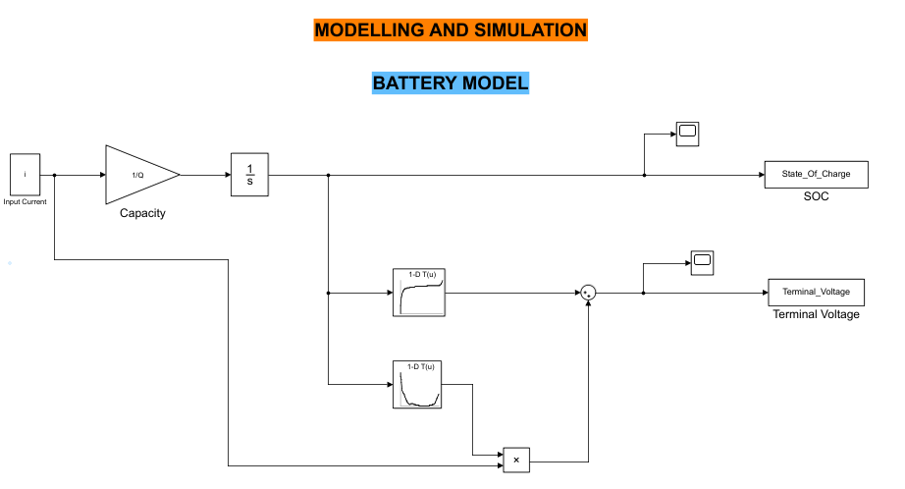
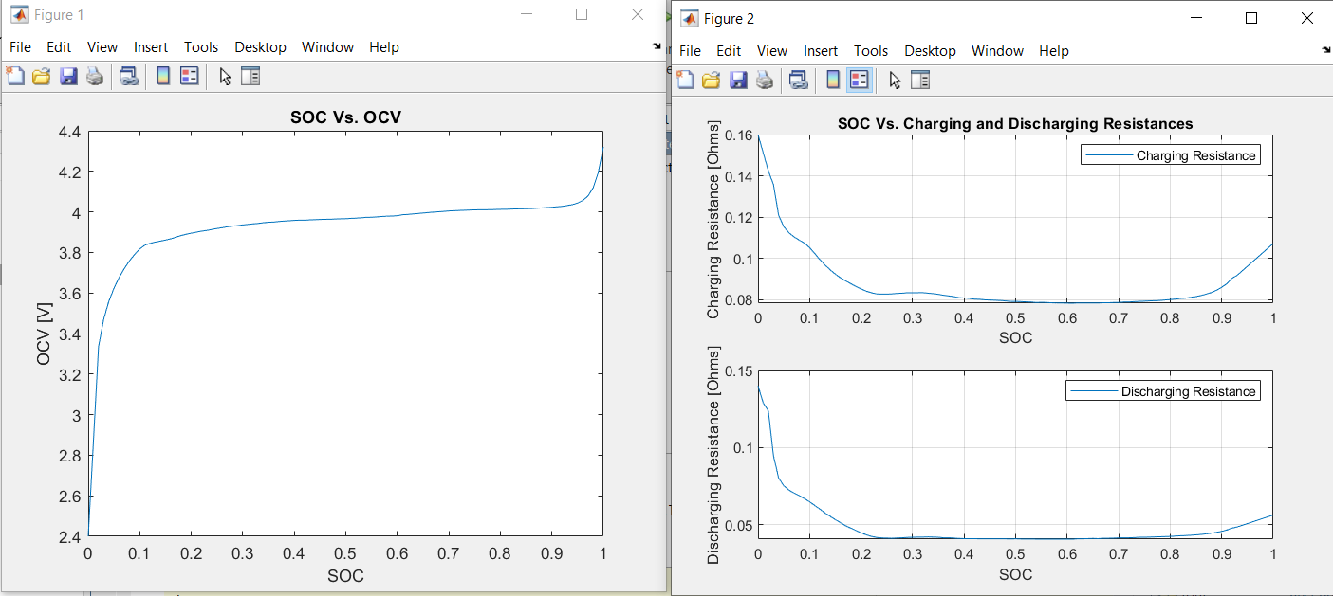
BATTERY MODEL

